Slide 1
Coordinate Reference Frames
Chun-Yuan Lin
CG
115/11/07

Slide 2
Coordinate Representations (1)
To generate a picture using a programming package, we first need to give the geometric descriptions of the objects that are to be displayed.
These descriptions determine the locations and shapes of the objects.
  A box is specified by the positions of its corners (vertices)
  A sphere is defined by its center position and radius.
With few exceptions, general graphics packages require geometric descriptions to be specified in a standard, right-hand, Cartesian-coordinate reference frame.
CG
115/11/07

Slide 3
Coordinate Representations (2)
If coordinate values for a picture are given in some other reference frame, they must to be converted to Cartesian-coordinate before they can be input to the graphics package. (other systems may be not)
Several different Cartesian reference frames are used in the process of constructing and display a scene.
  We can define the shapes of individual objects, such as tree, within a separate coordinate reference frame for each objects. (Modeling coordinate)(local coordinates, master coordinates)
  Once the individual object shapes have been specified, we can construct “model” a scene by placing the objects into appropriate locations within a scene reference frame. (World coordinates)
CG
115/11/07

Slide 4
Coordinate Representations (3)
Geometric descriptions in modeling coordinates and world coordinates can be given in any convenient floating-pointing or integer values, with regard for the constrains of a particular output device.
After all parts of a scene have been specified, the overall world coordinate description is processed through various routines onto one or more output-device reference frames for display. This process is called the viewing pipeline.
  World coordinate positions are first converted to viewing coordinates corresponding to the view we want of a scene, based on the position and orientation of a hypothetical camera.
CG
115/11/07

Slide 5
Coordinate Representations (4)
  Then object locations are transformed to a two-dimensional projection of the scene, which corresponds to what we will see on the output device.
  The scene is then stored in normalized coordinates, which each coordinate value is in the range from -1 to 1 or in the range from 0 to 1. (normalize device coordinates)
  Finally, the picture is scan converted into the refresh buffer of a raster system for display. The coordinate systems for display devices are generally called device coordinates, or screen coordinates in the case of a video monitor.
CG
115/11/07

Slide 6
Coordinate Representations (5)
An initial modeling-coordinating position (x_{mc}, y_{mc}, z_{mc}) in this illustration is transferred to world coordinates, then to viewing and projection coordinates, then to left-handed normalized coordinates, and finally to a device-coordinate position (xdc, ydc) with the sequences:
(x_{mc}, y_{mc}, z_{mc}) → (x_{wc}, y_{wc}, z_{wc}) → (x_{vc}, y_{vc}, z_{vc}) → (x_{pc}, y_{pc}, z_{pc})
→ (x_{nc}, y_{nc}, z_{nc}) → (x_{dc}, y_{dc})
Device coordinates (x_{dc}, y_{dc}) are integer within the range (0,0) to (x_{max}, y_{max}) for a particular output device.
CG
115/11/07

Slide 7
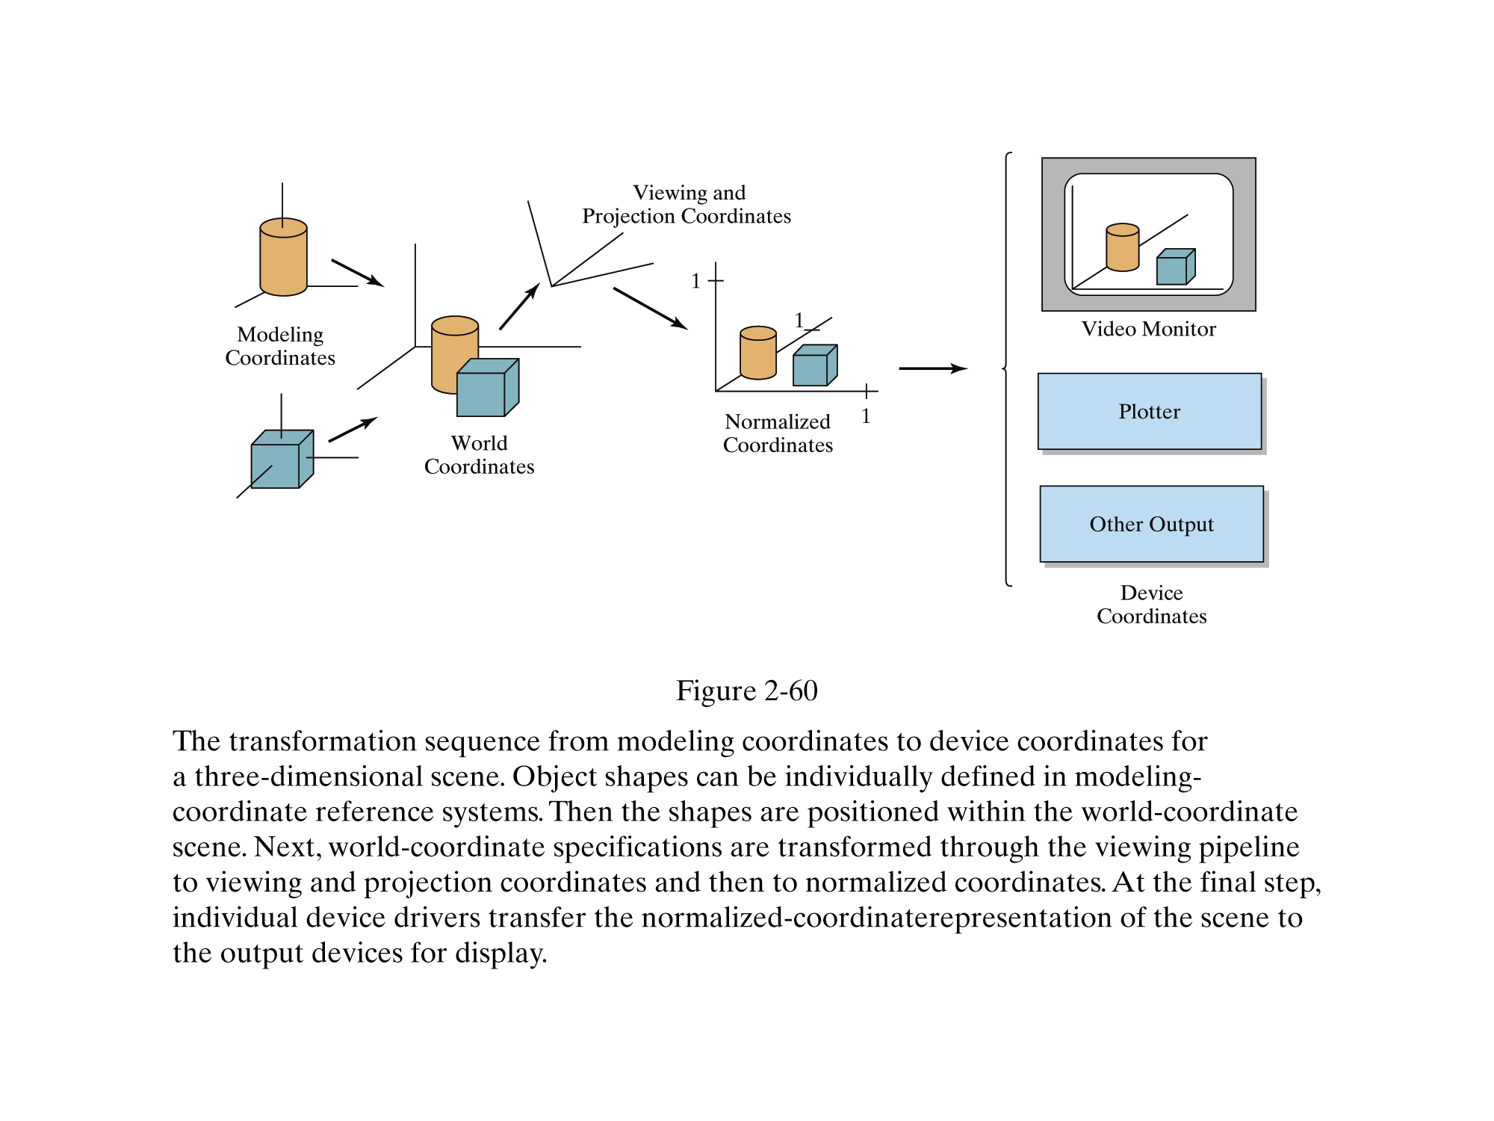

Slide 8
Variety of mathematical concepts and techniques are employed in computer-graphics algorithms.
Both Cartesian and non-Cartesian reference frames are often useful in computer graphics applications.
We typically specify coordinates in a graphics program using a Cartesian reference system, but the initial specification of a scene could be given in a non-Cartesian frame of reference.
CG
115/11/07

Slide 9
Two-Dimensional Cartesian Screen Coordinates (1)
For the device-independent commands within a graphics package, screen-coordinate positions are referenced within the first quadrant of a two-dimensional Cartesian frame in standard position. The coordinate origin for this reference frame is at the lower-left screen corner.
Scan line, however, are numbered from 0 at the top of the screen, so that screen positions are represented internally with respect to the upper-left corner of the screen.
CG
115/11/07

Slide 10
Two-Dimensional Cartesian Screen Coordinates (2)
Therefore, device-dependent commands, such as those for interactive input and display window manipulations, often reference screen coordinates using the inverted Cartesian frame.
y
x
x
Cartesian frame
y
inverted Cartesian frame
CG
115/11/07

Slide 11
Standard Two-Dimensional Cartesian Reference Frames
We use Cartesian systems in standard position for world-coordinate specifications, viewing coordinates, and other references within the two-dimensional viewing pipeline.
CG
115/11/07

Slide 12
Polar Coordinates in the xy Plane (1)
A frequently used two-dimensional non-Cartesian system is a polar coordinate reference frame.
Positive angular displacements are counterclockwise, and negative angular displacements are clockwise. The relation between Cartesian and polar coordinates is shown below.
r
y
P
θ
r
θ
x
CG
115/11/07

Slide 13
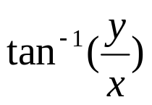

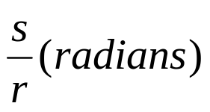

Polar Coordinates in the xy Plane (2)
We can transform from polar coordinates to Cartesian coordinates with the expressions.
x = r cosθ, y = r sinθ
The inverse transformation from Cartesian to polar coordinates is
r = , θ =
One radian is defined as a measure for an angle that is subtended by a circular arc that has length equal to the circle radius.
θ =
P
r
y
θ
x
s
θ
P
r
CG
115/11/07

Slide 14
Standard Three-Dimensional Cartesian Reference Frames
Figure A-6(a) shows the conventional orientation for the coordinate axes in a three-dimensional Cartesian reference system. This is called a right-handed system.
In most computer graphics programs, we specify object descriptions and other coordinate parameters in right-handed Cartesian coordinates. (assume that all Cartesian reference frames are right-handed unless specifically stated otherwise)
Cartesian reference frames are orthogonal coordinate systems, which just means that the coordinate axes are perpendicular to each other. Also in Cartesian frames, the axes are straight lines.
CG
115/11/07

Slide 15
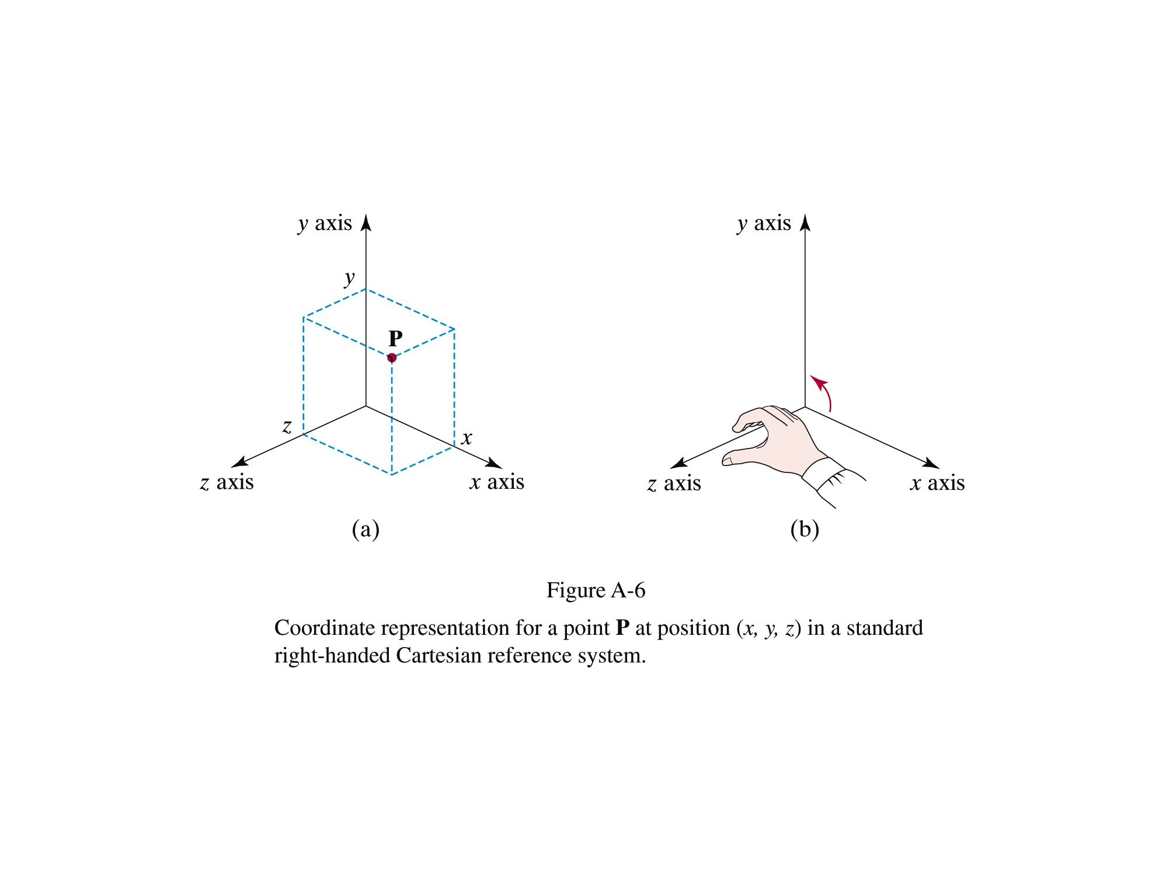

Slide 16
Three-Dimensional Cartesian Screen Coordinates
When a view of a three-dimensional scene is displayed on a video monitor, depth information is stored for each screen position. The three-dimensional position corresponding to each screen point is often referenced with the left-handed system.
CG
115/11/07

Slide 17
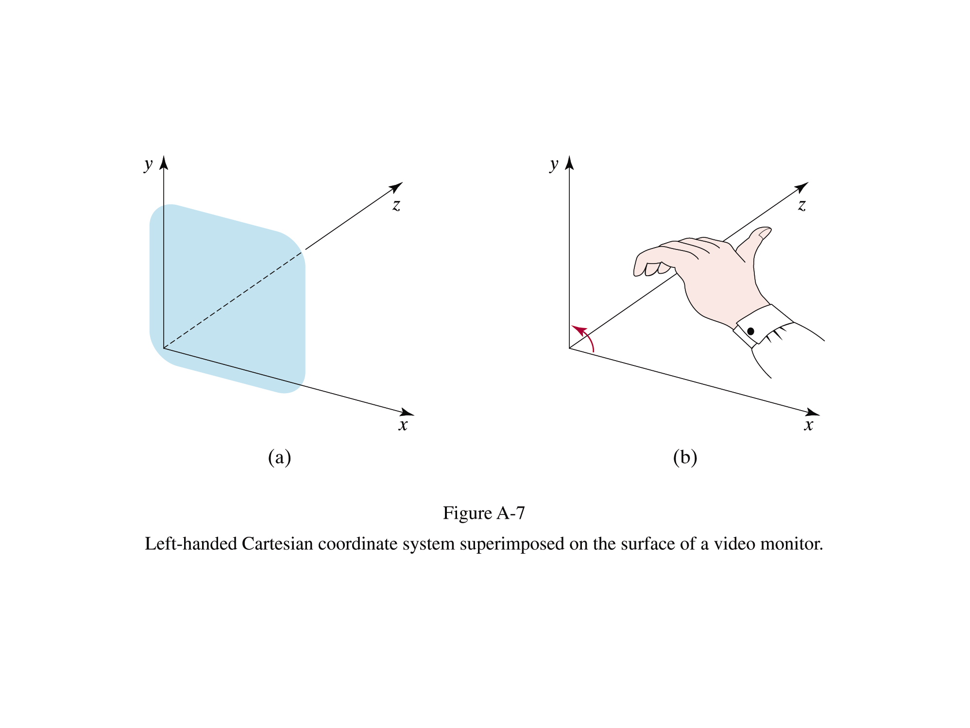

Slide 18
Three-Dimensional Curvilinear-Coordinate Systems (1)
Any non-Cartesian reference frame is referred to as a curvilinear-coordinate system.
The choice of coordinate system for a particular graphics application depends on a number of factors, such as symmetry, ease of computation, and visualization advantages.
Figure A-8 shows a general curvilinear-coordinate reference frame formed with three coordinate surfaces, where each surface has one coordinate held constant.
CG
115/11/07

Slide 19
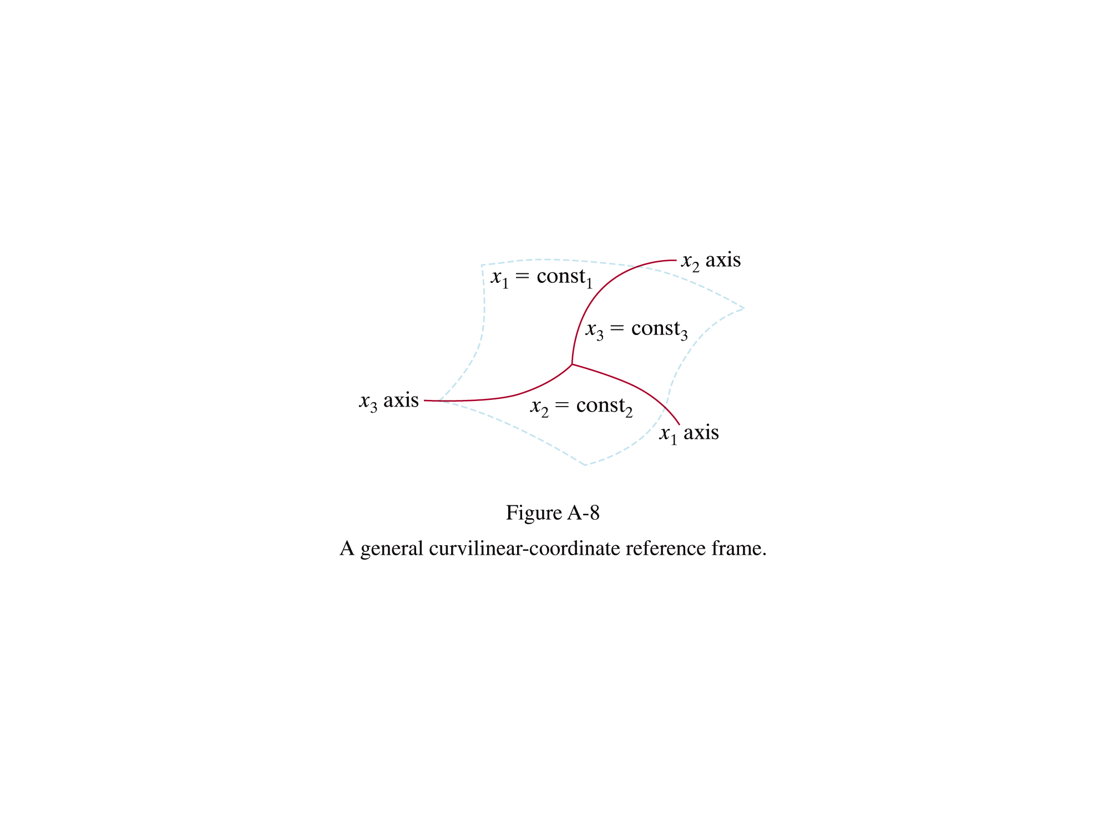

Slide 20
Three-Dimensional Curvilinear-Coordinate Systems (2)
A cylindrical-coordinate specification of a spatial position is shown in Fig. A-9 in relation to a Cartesian reference frame.
We can transform from a cylindrical-coordinate specification to a Cartesian reference frame with the calculations.
x = ρ cosθ, y = ρ sinθ, z = z
CG
115/11/07

Slide 21
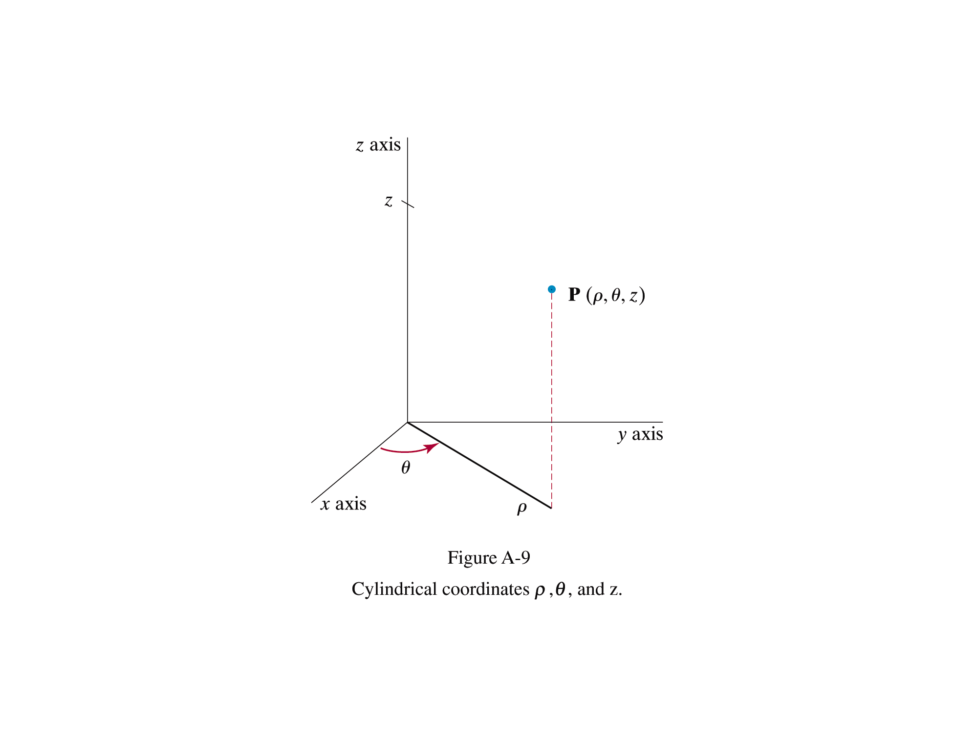

Slide 22
Three-Dimensional Curvilinear-Coordinate Systems (3)
Another commonly used curvilinear-coordinate specifications is the spherical-coordinate system in Fig. A-10.
Spherical coordinates are sometimes referred to as polar coordinates in three-dimensional space.
We can transform from a spherical-coordinate specification to a Cartesian reference frame with the calculations.
x = r cosθ sinφ , y = r sinθ sinφ, z = r cosφ
CG
115/11/07

Slide 23
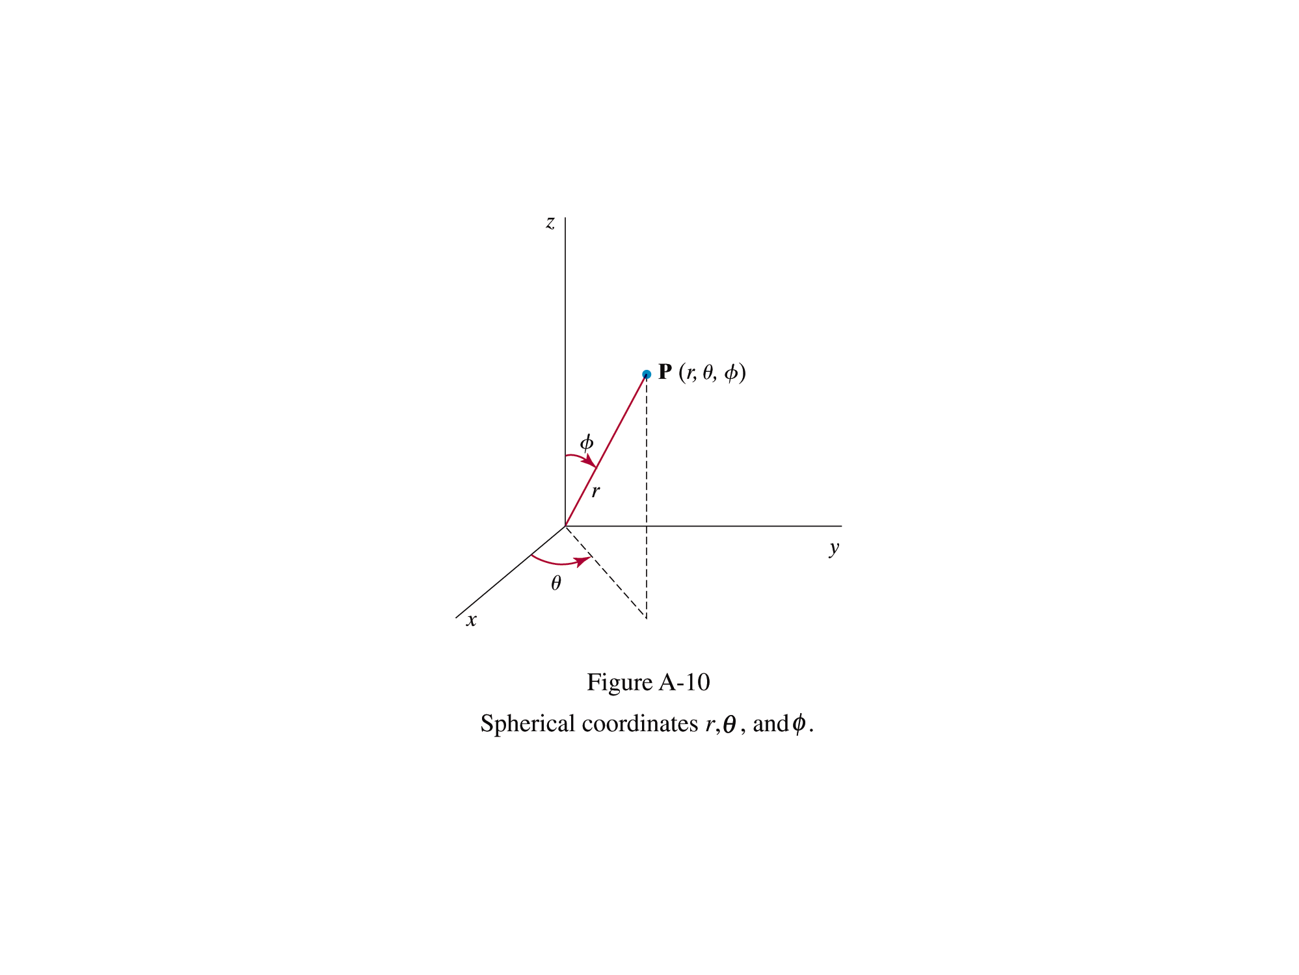

Slide 24
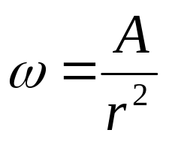
Solid Angle
The definition for a solid angle ω is formulated by analogy with the definition for a two-dimensional radian-angle θ between two intersecting lines.
The solid angle ω within the cone-shaped region with apex at P is defined as
The total area of the spherical surface is 4πr²
CG
115/11/07

Slide 25
